Slide 1

The Book of Job:
Why Do Bad Things Happen to Good People?

Slide 2
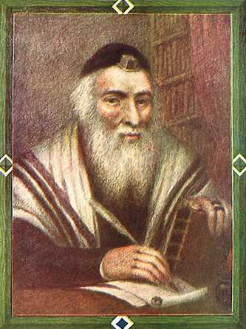
THE BOOK OF JOB

Slide 3
The Content of Job
Prologue 1.1-5
1. The Righteous can suffer without blaming God (2 Tim. 3.12).
2. Whatever happens on earth is either decreed or allowed by God.
3. Job was rich, and by his people’s criterion, he must be right with God.
4. Job was an admirable family man. Why would these things happen to him?

Slide 4
B. Job’s First Test 1.6-20
1. Satan is allowed to have control over everything Job has, except Job’s own body (Job 1.12).
2. Satan’s reasoning: if the “hedge” (v. 11) is trimmed which protects Job, he will curse God.
3. Job loses his cattle, his servants, and his children. His response? “Naked I came from my mother’s womb, and naked I will depart. . . May the name of the LORD be praised” (v. 20).

Slide 5
C. Job’s Second Test 2.1-10)
1. This is the “skin for skin” test. Satan believes his persecution has been unsuccessful because Job’s body was not harmed (v. 4).
God allows the test, but Job’s life must be spared.
So Satan afflicts Job with boils from head to toe. Job sits in ashes (for humility) and scrapes his body with broken pieces of pottery.

Slide 6
4. Job’s wife suggests he curse God and die.
5. Job’s three friends leave their homes to go to Job to comfort and sympathize with him (v. 11). Job and his three friends sit together for seven days and nights without speaking because they can see that his pain is great.

Slide 7

H. The THEOPHANIES (i.e., God’s Speeches— 38.1-42.6)
God’s First Discourse 38:1—40:5
1. God answers Job out of a whirlwind, “Who are you to confuse the issue without knowledge? Be strong, and answer me when I ask!” (38.1-3).
2. “Job (38.4--39.30),
a. Where were you when I laid the foundation of the earth?
b. Who set the measurements of the earth?
c. Who sunk its foundations?

Slide 8
d. Who gave birth to the earth and swaddled it with swaddling clothes?
e. Who encloses the earth and keeps you from destruction?
f. Have you commanded the morning to come?
g. Have you walked in the recesses of the deep?
h. Do you have the key to the gates of death?
j. Do you know the expanse of the earth?
k. Where does light, and darkness, dwell?

Slide 9
l. Do you know where snow and hail is stored?
m. How is the light divided? How is the east wind distributed on the earth?
n. Who channels the flood, or knows the path of lightning?
o. Does the rain have a Father?
p. Have you ordered the constellations in place?
q. Can you cause the rain to fall?
r. Who puts understanding in the mind?

Slide 10
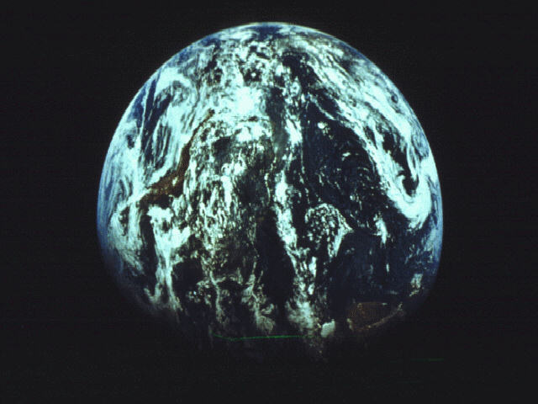
s. Can you feed the animals?
t. Do you control the reproduction of animals?
u. Who makes the animals to be domestic or wild?
v. Who gives the horse his might or the hawk and eagle their eyesight?”
3. “Will the faultfinder contend with the Almighty?” (40.2).
4. JOB’S ANSWER: “Behold I am insignificant; what can I reply to You?” (40.4).

Slide 11
H. The THEOPHANIES (i.e., God’s Speeches— 38.1- 42.6)
Second Discourse 40:6—42:6
1. The Lord (Yahweh) answers Job out of a storm, “Take
courage and answer me; will you really annul My
judgment?”
2. Job is told to adorn himself with eminence, dignity, honor, and majesty; and to pour out his anger (v. 11).
3. Job’s own right hand can save him (v. 14).
4. God’s Power is shown in His creatures:
a. The hippopotamus eats grass but is stronger
than many men (v. 15).
b. Can man catch Leviathan with a fishhook?
This is probably a reference to a crocodile. There is virtually no evidence that this is a dinosaur (41.1-34).

Slide 12
H. The THEOPHANIES (i.e., God’s Speeches— 38.1- 42.6)
Second Discourse 40:6—42:6
5. Job’s Response: “I know that You can do all things, and that no purpose of Yours can be thwarted. . . . I have heard of You by the hearing of the ear; but now my eye sees you. Therefore I retract, and I repent in dust and ashes” (42.2,5-6).
6. Job’s sin was subsequent to his suffering, not the cause of it.
7. God says to Eliphaz and the other two friends, “My wrath is kindled against you and against your two friends, because you have not spoken of Me what is right as My servant Job has” (42.7).
8. God instructs the three friends to take 7 bulls and 7 rams to Job for sacrifice, and to ask Job to pray for them (42.8).

Slide 13
EPILOGUE: Victory for Job 42.10-17
When Job prays the prayer requested by the 3 friends, God restored Job’s fortunes by giving him twice as much (v. 10).
All of Job’s relationships that he had before the suffering were restored. Each person gave him money and a gold ring (v. 11).
He has twice the livestock, and again he has 7 sons and 3 daughters (v. 13).
Job’s daughters were the fairest in the land.
5. Job lived an additional 140 years, lived to see four generations of his family, and died an old man “full of days.”

