Slide 1


12 Questions: Sexuality
Mt. Juliet church of Christ
Mt. Juliet church of Christ
July 14, 2014
Dr. Ralph Gilmore

Slide 2
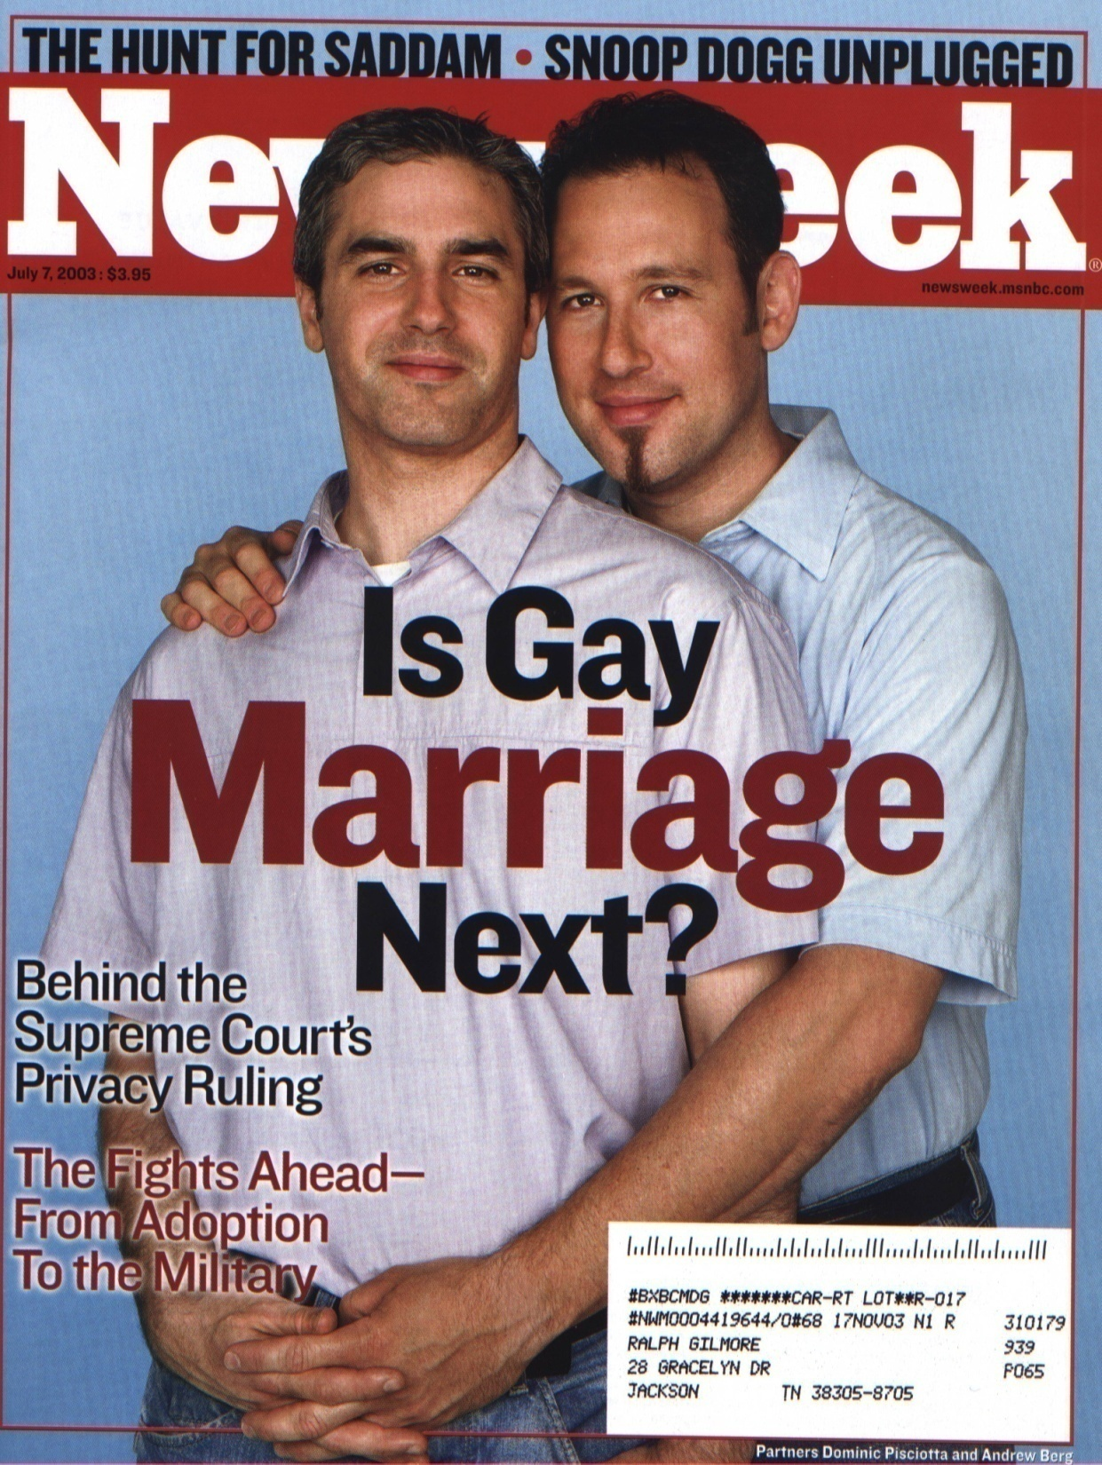

Slide 3
BASIC ARGUMENT FOR ALL HOMOSEXUAL MARRIAGES BEING SINFUL

Slide 4
THIS DISCUSSION IS NOT ABOUT HOMOSEXUAL ORIENTATION.
THIS DISCUSSION IS ABOUT THE PRACTICE OF HOMOSEXUALITY

Slide 5
Homosexual polygamy is against God's will.
Homosexual promiscuity is against God's will.
Bisexual behavior is against God's will.
Cult prostitution is against God's will.
And, homosexual love between two people committed to each other is also against God's will.

Slide 6
I AM NOT HOMOPHOBIC. I AM HAMARTIA-PHOBIC!

Slide 7
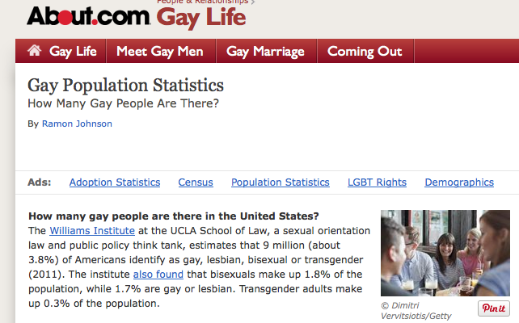
HOW MANY PEOPLE ARE GAY?

Slide 8
IS THERE A "GAY GENE"?

Slide 9
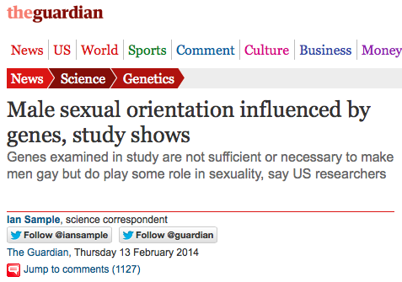

Slide 10
Quotes from "The Guardian" Article
"A study of gay men in the US has found fresh evidence that male sexual orientation is influenced by genes. Scientists tested the DNA of 400 gay men and found that genes on at least two chromosomes affected whether a man was gay or straight.
"A region of the X chromosome called Xq28 had some impact on men's sexual behaviour – though scientists have no idea which of the many genes in the region are involved, nor how many lie elsewhere in the genome.

Slide 11
"Another stretch of DNA on chromosome 8 also played a role in male sexual orientation – though again the precise mechanism is unclear...
"Michael Bailey, a psychologist at Northwestern University in Illinois, set out the findings at a discussion event held in conjunction with the annual meeting of theAmerican Association for the Advancement of Science in Chicagoon Thursday. 'The study shows that there are genes involved in male sexual orientation,' he said."

Slide 12
The Guardian seems overlook the fact that there is no evidence that might even suggest biological causation. "Influenced by, affected, some impact, played a role, involved." Not exactly a rousing case for the "born that way" crowd.
- See more at: http://www.onenewsnow.com/perspectives/bryan-fischer/2014/06/17/the-latest-in-scientific-research-there-is-no-gay-gene#sthash.6TneKFVG.dpuf

Slide 13
"The gene or genes in the Xq28 region that influence sexual orientation have a limited and variable impact. Not all of the gay men in Bailey's study inherited the same Xq28 region. The genes were neither sufficient, nor necessary, to make any of the men gay."

Slide 14
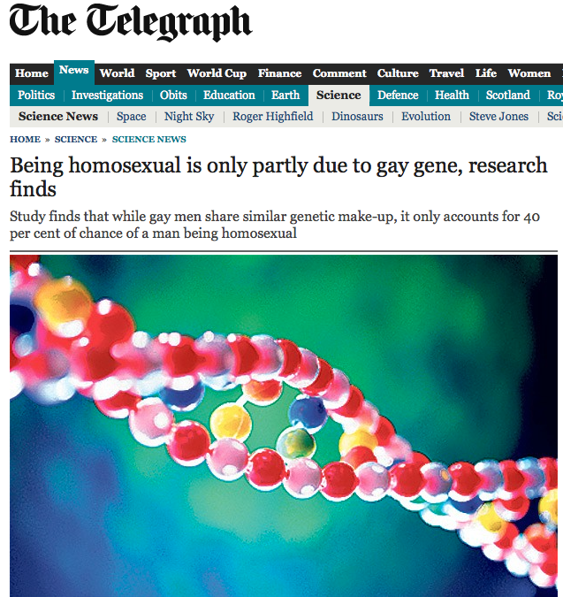

Slide 15
Homosexuality is only partly genetic with sexuality mostly based on environmental and social factors, scientists believe.
A study found that, while gay men shared similar genetic make-up, it only accounted for 40 per cent of the chance of a man being homosexual.

Slide 16
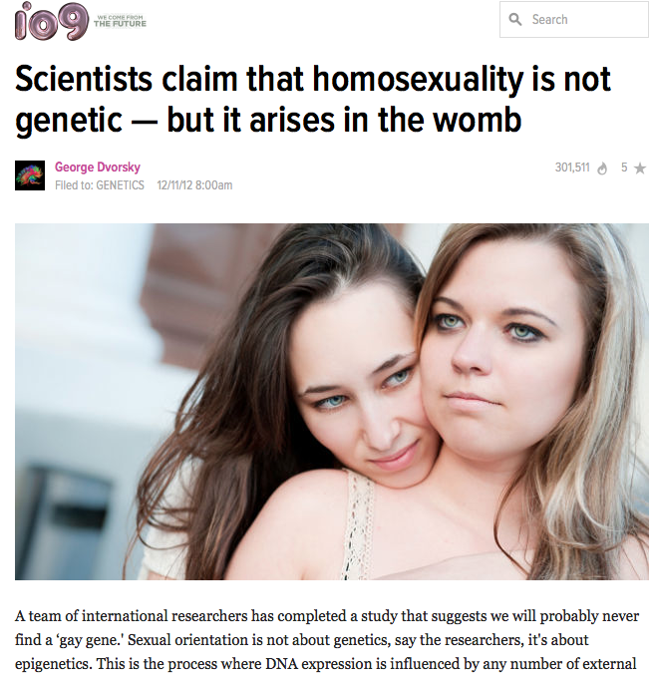

Slide 17
Normally, sex-specific marks that are triggered during early fetal development work to protect boys and girls in the womb from undergoing too much natural variation in testosterone, which should normally happen later in a pregnancy. . . These epi-marks can be transmitted across generations from fathers to daughters, or mothers to sons.
Essentially, Rice and Friberg believe they have discovered the presence of "sexually antagonistic" epi-marks — which sometimes carry over to the next generation and cause homosexuality in opposite-sex offspring.

Slide 18
Homosexuality is not biologically determined - latest research.
By David van Gend
As to the exact causes of homosexuality, the medical jury is still out. But the baseless claim, promoted by [Australian] Justice Michael Kirby and others, that gays are just born that way, is given no support by the American Psychiatric Association. Their Fact Sheet on Sexual Orientation (2000) sums it up: "There are no replicated scientific studies supporting any specific biological etiology for homosexuality"....

Slide 19
JESUS ON THE SUBJECT OF HOMOSEXUALITY

Slide 20
Jesus?
Jesus never spoke of homosexuality?
  It is true that Jesus never addressed this topic.
However, he also never specifically addressed pedophilia, bestiality, or a number of other sexual sins.
Does this mean that Jesus approved of homosexuality, just because he didn’t mention it?

Slide 21
Jesus?
In fact, every time Jesus spoke of sexual relations, it was in heterosexual terms.
  This should carry more weight than what he did not say.

Slide 22
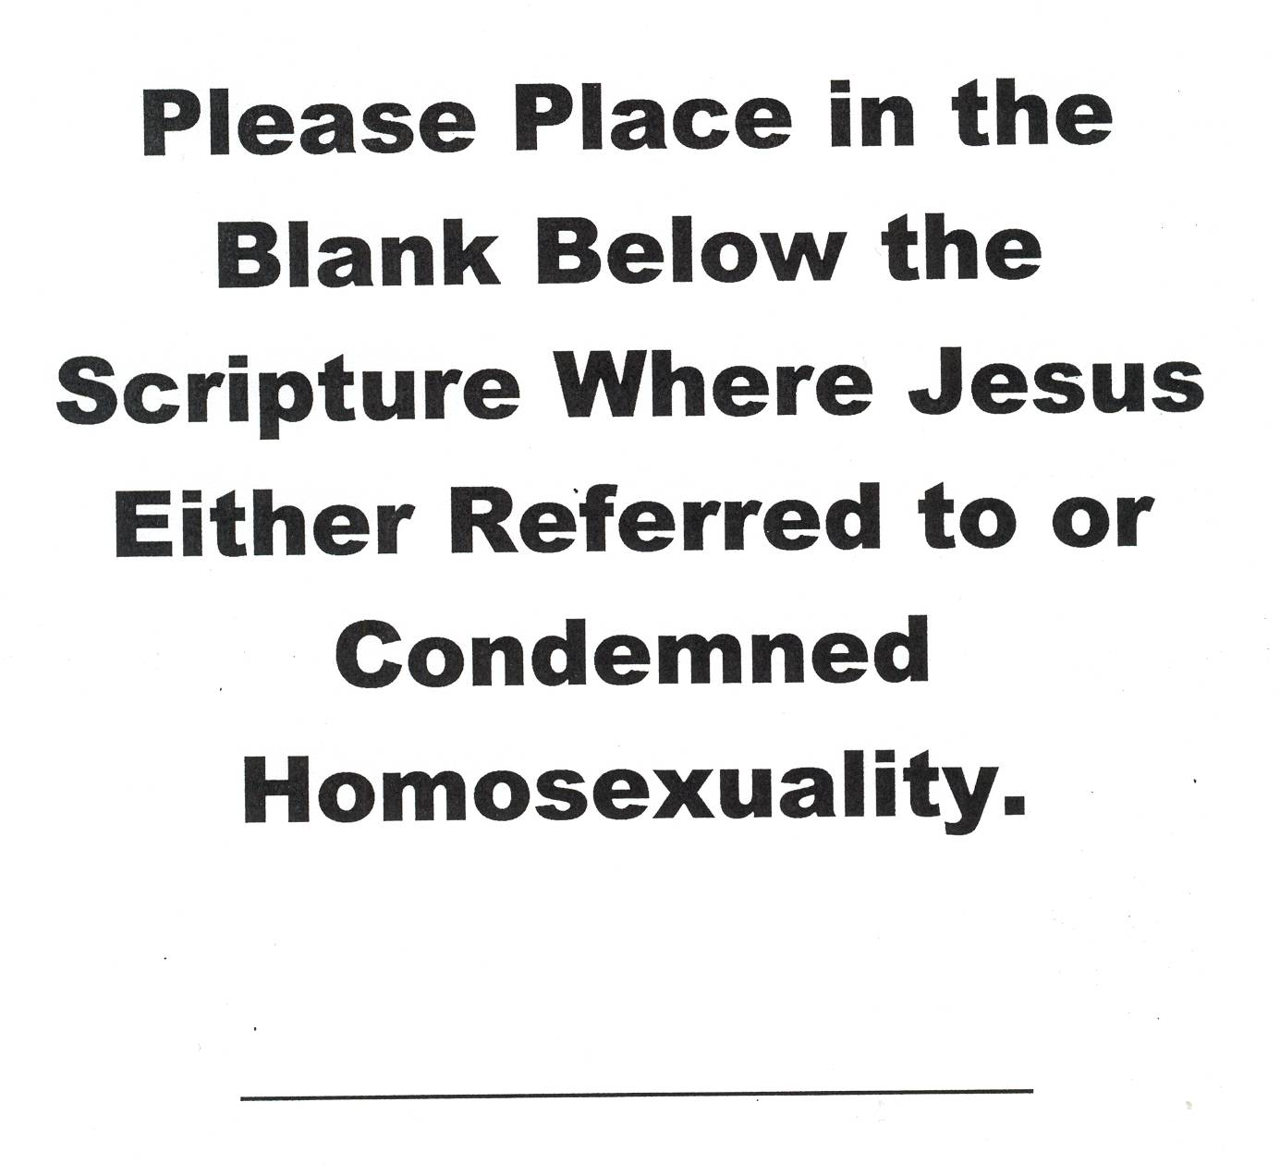
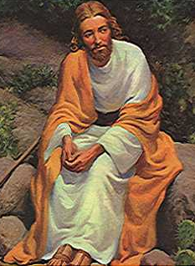

Slide 23
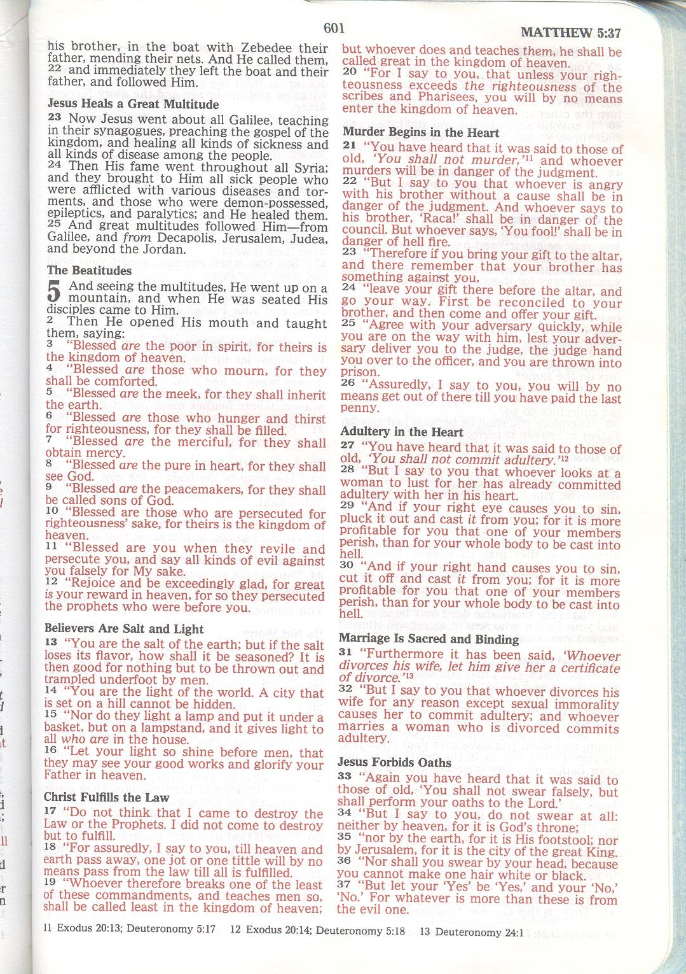
RED-LETTER HERMENEUTICS

Slide 24
PROBLEMS INVOLVED:
ABUSE OF “CULTURE ARGUMENT”
INTERPRETING WITH AN “AGENDA”
OVERLOOKING OBVIOUS CONCLUSIONS
SUCCOMBING TO MODERN CULTURE
RELINQUISHING BIBLE AUTHORITY

Slide 25

Matthew 19:3-6
3 Some Pharisees came to Jesus, testing Him and asking, " Is it lawful for a man to divorce his wife for any reason at all?" 4 And He answered and said, "Have you not read that He who created them from the beginning MADE THEM MALE AND FEMALE, 5 and said, 'FOR THIS REASON A MAN SHALL LEAVE HIS FATHER AND MOTHER AND BE JOINED TO HIS WIFE, AND THE TWO SHALL BECOME ONE FLESH'? 6 "So they are no longer two, but one flesh. What therefore God has joined together, let no man separate." NASU

Slide 26
WHAT DID JESUS SAY?
"Have you not read that He who created them from the beginning MADE THEM MALE AND FEMALE, 5 and said, 'FOR THIS REASON A MAN SHALL LEAVE HIS FATHER AND MOTHER AND BE JOINED TO HIS WIFE, AND THE TWO SHALL BECOME ONE FLESH'? NASU

Slide 27
“THE TWO SHALL BECOME ONE FLESH”

Slide 28
1 Corinthians 6:16-17
Or do you not know that the one who joins himself to a prostitute is one body with her? For He says, "THE TWO SHALL BECOME ONE FLESH." NASU

Slide 29
Matthew 19:10-12
10 The disciples said to Him, "If the relationship of the man with his wife is like this, it is better not to marry." 11 But He said to them, " Not all men can accept this statement, but only those to whom it has been given. 12 "For there are eunuchs who were born that way from their mother's womb; and there are eunuchs who were made eunuchs by men; and there are also eunuchs who made themselves eunuchs for the sake of the kingdom of heaven. He who is able to accept this, let him accept it." NASU

Slide 30
GOD DOES NOT RECOGNIZE HOMOSEXUAL MARRIAGES.
HE MADE MALES AND FEMALES PHYSICALLY SUITED TO HETEROSEXUAL MARRIAGE.

Slide 31
Romans 1:18-32

Slide 32
Dishonorable Passions
Romans 1
        Romans 1:26-27. (26) For this reason God gave them up to dishonorable passions. For their women exchanged natural relations for those that are contrary to nature; (27) and the men likewise gave up natural relations with women and were consumed with passion for one another, men committing shameless acts with men and receiving in themselves the due penalty for their error

Slide 33
Dishonorable Passions
Romans 1
“Contrary to nature”
Παρἀ φύσιν
Literally = “against nature”
1:32: “Though they know God’s righteous decree that those who practice such things deserve to die, they not only do them but give approval to those who practice them.”

Slide 34
STAGE ONE-- “GOD GAVE THEM OVER”:
1. TO IMPURITY (v. 24)

Slide 35
Romans 1.24-25
24 Therefore God gave them over in the lusts of their hearts to impurity, so that their bodies would be dishonored among them. 25 For they exchanged the truth of God for a lie, and worshiped and served the creature rather than the Creator, who is blessed forever. Amen.

Slide 36
STAGE TWO--“GOD GAVE THEM OVER”:
2. TO DEGRADING PASSIONS (v. 26)

Slide 37
Romans 1.26-27
26 For this reason God gave them over to degrading passions; for their women exchanged the natural function for that which is unnatural, 27 and in the same way also the men abandoned the natural function of the woman and burned in their desire toward one another, men with men committing indecent acts and receiving in their own persons the due penalty of their error.

Slide 38
STAGE THREE--“GOD GAVE THEM OVER”:
3. TO A DEPRAVED MIND (v. 28)

Slide 39
Romans 1.28
28 And just as they did not see fit to acknowledge God any longer, God gave them over to a depraved mind, to do those things which are not proper,

Slide 40
Romans 1.29-32
29 being filled with all unrighteousness, wickedness, greed, evil; full of envy, murder, strife, deceit, malice; they are gossips, 30 slanderers, haters of God, insolent, arrogant, boastful, inventors of evil, disobedient to parents, 31 without understanding, untrust-worthy, unloving, unmerciful; 32 and although they know the ordinance of God, that those who practice such things are worthy of death, they not only do the same, but also give hearty approval to those who practice them. NASU

Slide 41
FINAL STATE— They know the consequences of their actions, but do them anyway (v. 32).

Slide 42
Romans 1: Pederasty
Does Paul only condemn pederasty in Romans 1, therefore leaving all other forms of homosexual relations as acceptable?
1. Paul does not bring up the subject of age in Romans 1 when referring to sin.
    He could have used the word “pederast” (παιδεράστης)
2. The attempt to limit Paul’s meaning to pederasty ignores the fact the he refers to a “mutual desire”( between the male partners)

Slide 43
Romans 1: Pederasty
2. The attempt to limit Paul’s meaning to pederasty ignores the fact the he refers to a “mutual desire”(ὄρεξις) between the male partners
3. Also, Paul’s use of wording for “males” (ἄρσενες) emphasizes gender regardless of age

Slide 44
Romans 1: Pederasty
4. We should remember that Paul condemns both lesbian and homosexual relations, linked by the words “in the same way,” “likewise,” etc.

Slide 45
Romans 1: “Exchange of natural inclinations" Argument
Does Paul only condemn those who “exchange” their own natural inclination from heterosexuality towards homosexuality, therefore accepting those who are constitutional homosexuals?
Remember Paul’s use of “against nature”
Romans 1:18-25
Romans 2:14,15

Slide 46
THE SINS OF ROMANS 1

Slide 47
The "Sins" of Romans 1:18-32
Suppressing the truth, not honoring God, were not thankful, they worshipped things instead of God (pantheism), made the truth of God a lie, lesbian and gay sex,wickedness, unrighteousness, greed, evil, envy, murder, strife, deceit, malice, gossips, slanderers, haters of God, insolent, arrogant, boastful, inventors of evil, disobedient to parents, foolish, untrustworthy, unloving, unmerciful, endorse others who do these things.

Slide 48
WORD STUDY OF “HOMOSEXUAL”

Slide 49
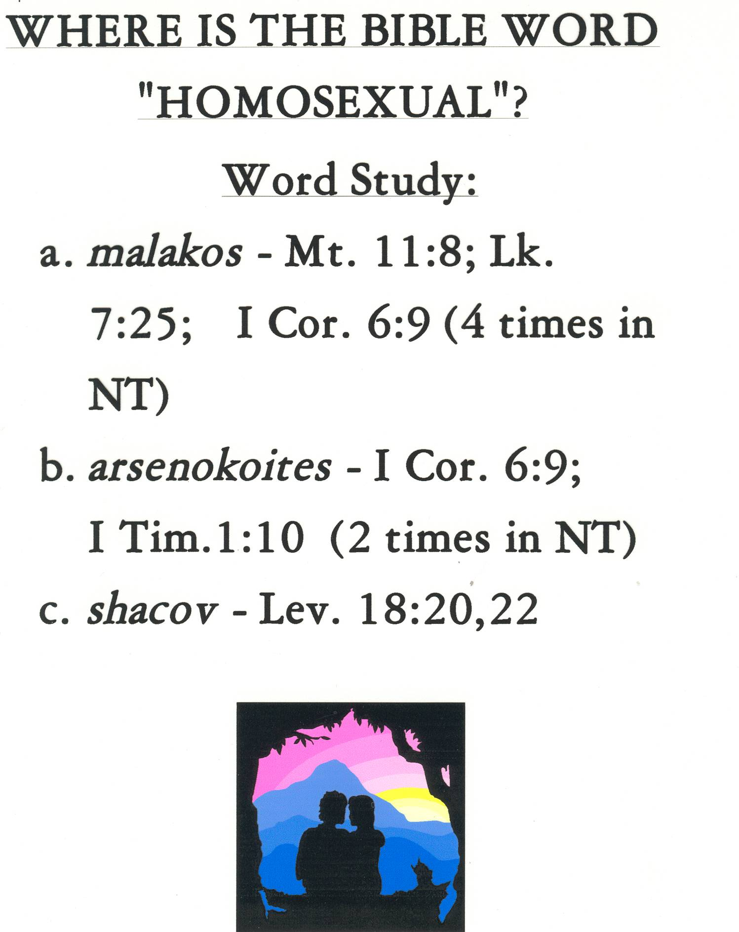

Slide 50
God’s Intentions for Humanity’s Sexuality (Genesis 1-2)

Slide 51
God’s Intentions for Humanity’s Sexuality
Genesis 1:27-28: (27) So God created man in his own image, in the image of God he created him; male and female he created them. (28) And God blessed them. And God said to them, “Be fruitful and multiply and fill the earth and subdue it, and have dominion over the fish of the sea and over the birds of the heavens and over every living thing that moves on the earth.”

Slide 52
The 6th Day
Genesis 2:18 (18) Then the Lord God said, “It is not good that the man should be alone; I will make him a helper fit for him.”
    Genesis 2:23-24 (23) Then the man said, “This at last is bone of my bones and flesh of my flesh; she shall be called Woman, because she was taken out of Man.” (24) Therefore a man shall leave his father and his mother and hold fast to his wife, and they shall become one flesh.

Slide 53
The 6th Day
“She shall be called woman, because she was taken out of Man.”
“and they shall become one flesh.”

Slide 54
Exclusions?
It is clear from writings that the Jews took the commands of Genesis 2:23-24 to exclude homosexual pairing. This is repeatedly stated in the Talmud.
“…and he shall cleave (hold fast), but not to a male.” –Talmud Sanhedrin 58a, Genesis 18.5

Slide 55
What do these verses teach?
Genesis 1 and 2 do not specifically condemn homosexuality
However, they do teach what God originally intended for a marriage relationship
One man + one woman

Slide 56
Prohibitions in Lev. 18 and 20

Slide 57
Prohibitions in Lev. 18 and 20
        Leviticus 18:22, 20:13. (18:22) You shall not lie with a male as with a woman; it is an abomination. (20:13) If a man lies with a male as with a woman, both of them have committed an abomination; they shall surely be put to death; their blood is upon them.

Slide 58
Leviticus 18 and 20
Leviticus makes it clear that when a man has intercourse with another male (to lie with), it violates God’s basic created order
These actions = abominations (detestable acts)
20:13 sheds more light with the phrase “they shall surely be put to death.”

Slide 59
1 Corinthians 6:9-11

Slide 60
Μαλακός, ἀρσενοκοῖται
1 Corinthians 6:9-11
    ⁹ Or do you not know that the unrighteous will not inherit the kingdom of God? Do not be deceived: neither the sexually immoral, nor idolaters, nor adulterers, nor men who practice homosexuality, ¹⁰ nor thieves, nor the greedy, nor drunkards, nor revilers, nor swindlers will inherit the kingdom of God. ¹¹ And such were some of you. But you were washed, you were sanctified, you were justified in the name of the Lord Jesus Christ and by the Spirit of our God.

Slide 61
1 Corinthians 6:9
ἢ οὐκ οἴδατε ὅτι ἄδικοι θεοῦ βασιλείαν οὐ κληρονομήσουσιν; μὴ πλανᾶσθε:οὔτε πόρνοι οὔτε εἰδωλολάτραι οὔτε μοιχοὶ οὔτε μαλακοὶ οὔτε ἀρσενοκοῖται

Slide 62
Μαλακός, ἀρσενοκοῖται
1 Corinthians 6
“men who practice homosexuality”
μαλακός- 1) to be yielding to the touch, soft. 2) being passive in a same-sex relationship, effeminate; esp. of boys who were sodomized by other males in such a relationship.
ἀρσενοκοίτης- a male who engages in sexual activity with a person of his own sex.

Slide 63
Μαλακός, ἀρσενοκοῖται
1 Corinthians 6
“Paul considers homoeroticism to be a ‘dishonorable passion’…one of the males must act like a woman, and one of the males must act like a male. Or as Philo says, the males become ‘womanish.’ For this reason I have chosen to translate the μαλακοἰ as ‘those males who are penetrated sexually by males’ and the ἀρσενοκοῖται as ‘those males who sexually penetrate males.’” – David E. Garland, Ph.D. Baylor U.

Slide 64
Genesis 19: Inhospitality

Slide 65
Genesis 19: Inhospitality
This is a sin of “inhospitality to the visitors to Sodom.”
Yadha is not the normal word used for homosexual intercourse (shakhabh) and therefore should be taken to mean “knowing something.”

Slide 66
Gen. 19: "Inhospitality" Argument
Lot was a prominent social figure in Sodom
He knew that the visitors spending the night in public was a bad idea
If the men of Sodom only wanted to “get to know” the visitors
  1. Why would Lot see it as a serious breach of hospitality?
  2. Why would it be deemed “seriously wicked?” –v.6,7
  3. Why would Lot offer his daughters?

Slide 67
Conclusions
The Bible teaches that the practice of homosexuality is not God’s original design for sexual relations.
  Genesis 1 & 2
The Bible teaches that the practice of homosexuality is sin
  Genesis 19
  Leviticus 18, 20
  Romans 1
  1 Corinthians 6

Slide 68
Conclusions
The Bible teaches that the practice of homosexuality is on the list of sins in Romans one that separate us from God.
The Bible teaches that we should have "radical" compassion on those who struggle with their sins, as we all so.

Slide 69
OTHER RELEVANT PASSAGES

Slide 70
1 TIMOTHY 1:8-11
8 But we know that the Law is good, if one uses it lawfully, 9 realizing the fact that law is not made for a righteous person, but for those who are lawless and rebellious, for the ungodly and sinners, for the unholy and profane, for those who kill their fathers or mothers, for murderers 10 and immoral men and homosexuals and kidnappers and liars and perjurers, and whatever else is contrary to sound teaching, NASU

Slide 71
JUDE 6-7
6 And the angels who did not stay within their own position of authority, but left their proper dwelling, he has kept in eternal chains under gloomy darkness until the judgment of the great day— 7 just as Sodom and Gomorrah and the surrounding cities, which likewise indulged in sexual immorality and pursued unnatural desire,[a] serve as an example by undergoing a punishment of eternal fire.

