Slide 1
Heaven

Slide 2
“But we do not want you to be uninformed, brethren, about those who are asleep, so that you will not grieve as do the rest who have no hope” (1 Thessalonians 4:13)

Slide 3
Notes:
O.T. setting
Gentile setting
Sadducee setting
Jewish Messiah setting
Modern setting (research on hope, current problems)

Slide 4
2 Timothy 1:8b-10 …God, who has saved us and called us with a holy calling, not according to our works, but according to His own purpose and grace which was granted us in Christ Jesus from all eternity, but now has been revealed by the appearing of our Savior Christ Jesus, who abolished death and brought life and immortality to light through the gospel

Slide 5
Matthew 5:12 “Rejoice and be glad, for your reward in heaven is great….
1 Peter 1:3 Blessed be the God and Father of our Lord Jesus Christ, who according to His great mercy has caused us to be born again to a living hope through the resurrection of Jesus Christ from the dead, ⁴ to obtain an inheritance which is imperishable and undefiled and will not fade away, reserved in heaven for you,

Slide 6
It’s the Person
not the Place

Slide 7
What is heaven like?
Who goes there?
What will we be like?
Who is there?

Slide 8
What is heaven like?
Who goes there?
What will we be like?
Who is there?

Slide 9
Earth’s Atmosphere (2 Peter 3:10)
Outer space (Hebrews 11:6)
Dwelling of God (Matthew 6:9)
Typically pictured as “up” (Acts 1:9)

Slide 10
The Gospel of John
Proclamation: Tells of his death (John 13)
Parting: Tells them he is leaving (John 13-14)
Points: Points to love (13) and faithfulness (15)
Presence:
Says the Holy Spirit will be with them (John 14-16)
Says Father and Son will be with them (John 17)
Says they will be with Father/Son (John 14, 17)

Slide 11
John 14:1 “Do not let your heart be troubled; believe in God, believe also in Me. 2 “In My Father’s house are many dwelling places; if it were not so, I would have told you; for I go to prepare a place for you. 3 “If I go and prepare a place for you, I will come again and receive you to Myself, that where I am, there you may be also.

Slide 12
⁵⁵ But being full of the Holy Spirit, he gazed intently into heaven and saw the glory of God, and Jesus standing at the right hand of God; ⁵⁶ and he said, “Behold, I see the heavens opened up and the Son of Man standing at the right hand of God.”
(Acts 7:55-56; cf. 1 Peter 3:22)

Slide 13
Not on Earth
Jesus left to go to it (John 14:1-2, Acts 1:9)
Jesus’ kingdom not of this world (John 18:36)
No Scripture says Jesus will set foot on earth

Slide 14
16 For the Lord Himself will descend from heaven with a shout, with the voice of the archangel and with the trumpet of God, and the dead in Christ will rise first. 17 Then we who are alive and remain will be caught up together with them in the clouds to meet the Lord in the air, and so we shall always be with the Lord. 18 Therefore comfort one another with these words.
(1 Thessalonians 4:16-18)

Slide 15
Not on Earth
Jesus left to go to it (John 14:1-2)
Jesus’ kingdom not of this world (John 18:35-36)
No Scripture says Jesus will set foot on earth
He is already reigning (Acts 7:55; Hebrews 8:1)
Stops reigning at his return (1 Corinthians 15:22-28)
Current heavens/earth burned up (2 Peter 3:9)
New heavens/earth (2 Peter 3:13; Revelation 21:1)

Slide 16
Revelation 21:1 Then I saw a new heaven and a new earth; for the first heaven and the first earth passed away, and there is no longer any sea. ² And I saw the holy city, new Jerusalem, coming down out of heaven from God, made ready as a bride adorned for her husband. (cf. 2 Peter 3:13)

Slide 17
WHAT IS HAPPENING?
1-3: CHRIST AMONG THE CHURCHES
4-11: CHRIST OPENS THE BOOK OF DESTINY
12-20: CHRIST OVERCOMES THE DRAGON
21-22: CHRIST AMONG HIS PEOPLE
Rev 21:3 And I heard a loud voice from the throne, saying, "Behold, the tabernacle of God is among men, and He will dwell among them, and they shall be His people, and God Himself will be among them, NASU

Slide 18
O.T. SYMBOLS
Revelation 21:1-4
1 Then I saw a new heaven and a new earth; for the first heaven and the first earth passed away, and there is no longer any sea. 2 And I saw the holy city, new Jerusalem, coming down out of heaven from God, made ready as a bride adorned for her husband. 3 And I heard a loud voice from the throne, saying, "Behold, the tabernacle of God is among men, and He will dwell among them, and they shall be His people, and God Himself will be among them, 4 and He will wipe away every tear from their eyes; and there will no longer be any death; there will no longer be any mourning, or crying, or pain; the first things have passed away." NASU

Slide 20
ALL THINGS NEW
GENESIS
Heavens/Earth created (1:1)
Sun Created (1:6)
Night Established (1:5)
Seas Created (1:10)
Curse Announced (3:14-17)
Death Enters (3:19)
Driven from Tree (3:24)
Sorrow/Pain Begins (3:17)
REVELATION
New Heavens/Earth (21:1)
No Need of Sun (21:23)
No Night There (22:5)
No More Seas (21:1)
No More Curse (22:3)
No More Death (21:4)
Restored to Tree (22:14)
No Tears or Pain (21:4)

Slide 21
PROPHECY FULFILLED
“Most of John’s imagery in this chapter reflects Isaiah 60 and 65 and Ezekiel 40-48. John weaves the New Jerusalem vision of Isaiah together with the new temple vision of Ezekiel. The Multiple OT promises converging in John’s mind seem to indicate that he viewed the New Jerusalem as the fulfillment of all these strands of prophecy” (Alan Johnson, Expositor’s, 591).

Slide 22
COMPARISON TO EZEKIEL
High Mountain Ez 40:2 Rev 21:10
Holy city, Taber. Ez 37:27 Rev 21:11
City Foursquare Ez 48:16,30 Rev 21:16
Having 12 Gates Ez 48:30-34 Rv 21:12-13
River of Life Ez 47:1 Rev 22:1
Trees, Leaves Ez 47:7, 12 Rev 22:2
[Sam Hester, 7.21.10]

Slide 23
Revelation 21:4 and He will wipe away every tear from their eyes; and there will no longer be any death; there will no longer be any mourning, or crying, or pain; the first things have passed away.

Slide 24
THE LAST ENEMY
1 Corinthians 15:25-26 25 For He must reign until He has put all His enemies under His feet. 26 The last enemy that will be abolished is death. NASU

Slide 25
Revelation 21:4 and He will wipe away every tear from their eyes; and there will no longer be any death; there will no longer be any mourning, or crying, or pain; the first things have passed away.

Slide 26
IMAGERY OF HEAVEN

Slide 27
Revelation 21:10-14
10 And he carried me away in the Spirit to a great and high mountain, and showed me the holy city, Jerusalem, coming down out of heaven from God, 11 having the glory of God. Her brilliance was like a very costly stone, as a stone of crystal-clear jasper. 12 It had a great and high wall, with twelve gates, and at the gates twelve angels; and names were written on them, which are the names of the twelve tribes of the sons of Israel. 13 There were three gates on the east and three gates on the north and three gates on the south and three gates on the west. 14 And the wall of the city had twelve foundation stones, and on them were the twelve names of the twelve apostles of the Lamb. NASU
SAINTS OF OLD AND NEW COVENANT INCLUDED

Slide 28
Rev 21:15-17
15 The one who spoke with me had a gold measuring rod to measure the city, and its gates and its wall. 16 The city is laid out as a square, and its length is as great as the width; and he measured the city with the rod, fifteen hundred miles; its length and width and height are equal. 17 And he measured its wall, seventy-two yards, according to human measurements, which are also angelic measurements. NASU

Slide 29
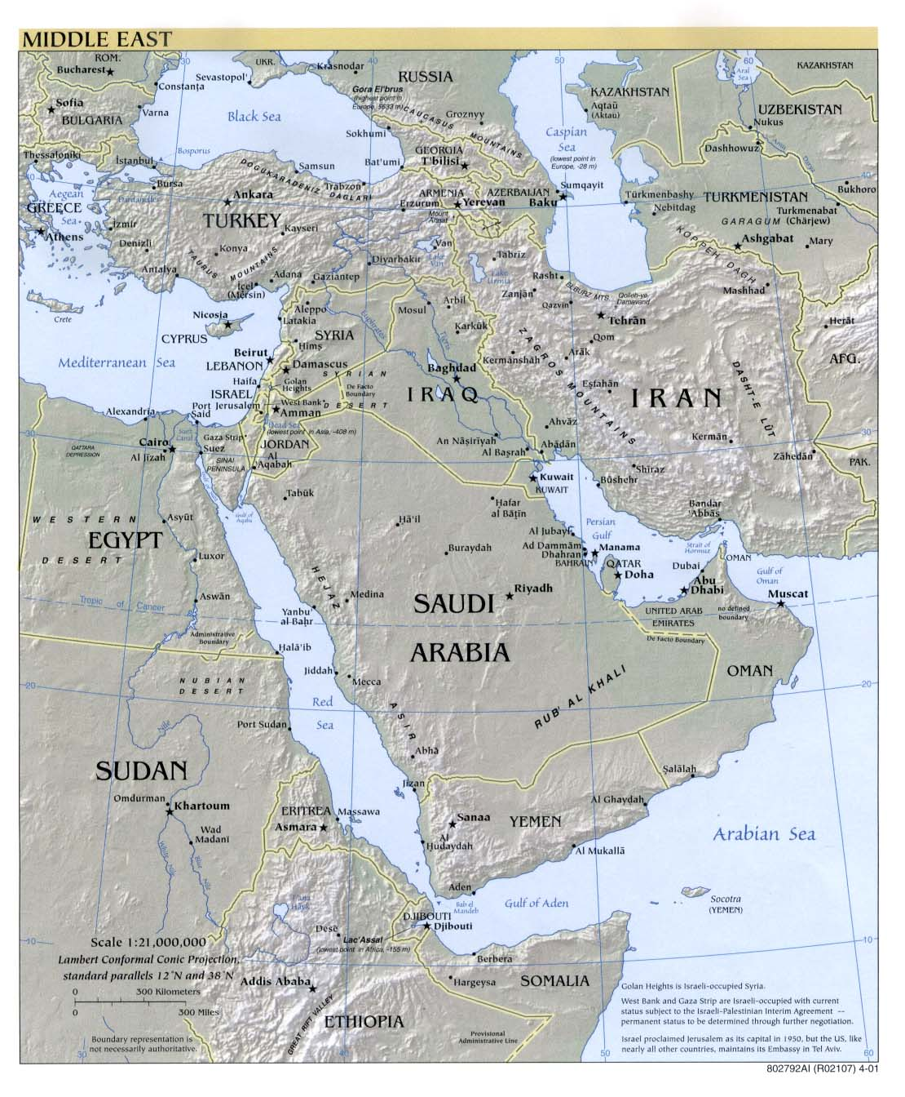
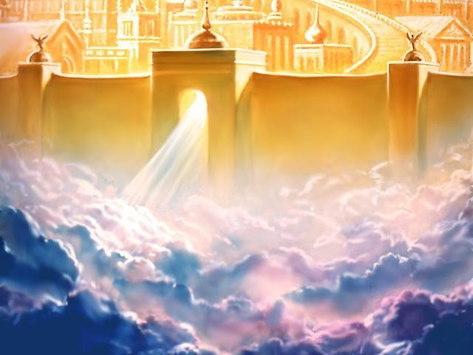
Three-fourths the size of the United States

Slide 30
Rev 21:18-21
18 The material of the wall was jasper; and the city was pure gold, like clear glass. 19 The foundation stones of the city wall were adorned with every kind of precious stone. The first foundation stone was jasper; the second, sapphire; the third, chalcedony; the fourth, emerald; 20 the fifth, sardonyx; the sixth, sardius; the seventh, chrysolite; the eighth, beryl; the ninth, topaz; the tenth, chrysoprase; the eleventh, jacinth; the twelfth, amethyst. 21 And the twelve gates were twelve pearls; each one of the gates was a single pearl. And the street of the city was pure gold, like transparent glass. NASU

Slide 32
PERFECTION
PRESENCE: God, Cube, Gates, Size
PAINLESS: No Sorrow, tears, pain
PICTURE OF BEAUTY: Gold, stones
PURITY: Nothing unclean, light
PROTECTION: Walls, foundation, Angel
PROVISION – Water of Life, Tree of Life

Slide 33
POWER TO PERSECUTED
PRESENCE – Torn from loved ones
PAINLESS – Pain and suffering
PICTURE OF BEAUTY – Dungeon
PURITY – Filth of prison cells
PROTECTION – Torn from homes
PROVISION – Starved in Roman prison

Slide 34
PARADISE
Rev 22:1-5
1 Then he showed me a river of the water of life, clear as crystal, coming from the throne of God and of the Lamb, 2 in the middle of its street. On either side of the river was the tree of life, bearing twelvekinds of fruit, yielding its fruit every month; and the leaves of the tree were for the healing of the nations. 3 There will no longer be any curse; and the throne of God and of the Lamb will be in it, and His bond-servants will serve Him; 4 they will see His face, and His name will be on their foreheads. 5 And there will no longer be any night; and they will not have need of the light of a lamp nor the light of the sun, because the Lord God will illumine them; and they will reign forever and ever. NASU

Slide 35
PARADISE REGAINED
TREE (Gen 2:9)
RIVER (Gen 2:10)
CURSE (Gen 3:14-16)
PRESENCE (Gen 3:8)
Gen 3:24 So He drove the man out; and at the east of the garden of Eden He stationed the cherubim and the flaming sword which turned every direction to guard the way to the tree of life. NASU
TREE (Rev 22:2)
RIVER (Rev 22:1)
NO CURSE (Rev 22:3)
GOD (Rev 22:4)
Rev 22:14 14 Blessed are those who wash their robes, so that they may have the right to the tree of life, and may enter by the gates into the city. NASU

Slide 36
What is heaven like?
Who goes there?
What will we be like?
Who is there?

Slide 37
²⁴ The nations will walk by its light, and the kings of the earth will bring their glory into it. ²⁵ In the daytime (for there will be no night there) its gates will never be closed; ²⁶ and they will bring the glory and the honor of the nations into it; ²⁷ and nothing unclean, and no one who practices abomination and lying, shall ever come into it, but only those whose names are written in the Lamb’s book of life. Revelation 21:24-27

Slide 38
Matthew 7:13 “Enter through the narrow gate; for the gate is wide and the way is broad that leads to destruction, and there are many who enter through it. ¹⁴ “For the gate is small and the way is narrow that leads to life, and there are few who find it.
Matthew 7:21 “Not everyone who says to Me, ‘Lord, Lord,’ will enter the kingdom of heaven, but he who does the will of My Father who is in heaven will enter.

Slide 39
John 14:3 “If I go and prepare a place for you, I will come again and receive you to Myself, that where I am, there you may be also. 4 “And you know the way where I am going.” 5 Thomas said to Him, “Lord, we do not know where You are going, how do we know the way?” 6 Jesus said to him, “I am the way, and the truth, and the life; no one comes to the Father but through Me. 7 “If you had known Me, you would have known My Father also; from now on you know Him, and have seen Him.

Slide 40
1 Pet. 1:3 Blessed be the God and Father of our Lord Jesus Christ, who according to His great mercy has caused us to be born again to a living hope through the resurrection of Jesus Christ from the dead, ⁴ to obtain an inheritance which is imperishable and undefiled and will not fade away, reserved in heaven for you, ⁵ who are protected by the power of God through faith for a salvation ready to be revealed in the last time.
John 8:23 And He was saying to them, “You are from below, I am from above; you are of this world, I am not of this world. ²⁴ “Therefore I said to you that you will die in your sins; for unless you believe that I am He, you will die in your sins.”

Slide 41
Gal. 3:26 For you are all sons of God through faith in Christ Jesus. ²⁷ For all of you who were baptized into Christ have clothed yourselves with Christ. ²⁸ There is neither Jew nor Greek, there is neither slave nor free man, there is neither male nor female; for you are all one in Christ Jesus. ²⁹ And if you belong to Christ, then you are Abraham’s descendants, heirs according to promise.

Slide 42
¹⁸ For Christ also died for sins once for all, the just for the unjust, so that He might bring us to God, having been put to death in the flesh, but made alive in the spirit;. . . .²¹ Corresponding to that, baptism now saves you — not the removal of dirt from the flesh, but an appeal to God for a good conscience — through the resurrection of Jesus Christ, ²² who is at the right hand of God, having gone into heaven, after angels and authorities and powers had been subjected to Him. 1 Peter 3:18-22 (cf. Romans 6:3-6)

Slide 43
What is heaven like?
Who goes there?
What will we be like?
Who is there?

Slide 44
Rom. 8:9 However, you are not in the flesh but in the Spirit, if indeed the Spirit of God dwells in you. But if anyone does not have the Spirit of Christ, he does not belong to Him. . . . ¹¹ But if the Spirit of Him who raised Jesus from the dead dwells in you, He who raised Christ Jesus from the dead will also give life to your mortal bodies through His Spirit who dwells in you.

Slide 45
1Cor. 15:50 Now I say this, brethren, that flesh and blood cannot inherit the kingdom of God; nor does the perishable inherit the imperishable. ⁵¹ Behold, I tell you a mystery; we will not all sleep, but we will all be changed, ⁵² in a moment, in the twinkling of an eye, at the last trumpet; for the trumpet will sound, and the dead will be raised imperishable, and we will be changed. ⁵³ For this perishable must put on the imperishable, and this mortal must put on immortality.

Slide 46
1 Cor. 15:54 But when this perishable will have put on the imperishable, and this mortal will have put on immortality, then will come about the saying that is written, “DEATH IS SWALLOWED UP in victory. ⁵⁵ “O DEATH, WHERE IS YOUR VICTORY? O DEATH, WHERE IS YOUR STING?” ⁵⁶ The sting of death is sin, and the power of sin is the law; ⁵⁷ but thanks be to God, who gives us the victory through our Lord Jesus Christ.

Slide 47
Phil. 3:20 For our citizenship is in heaven, from which also we eagerly wait for a Savior, the Lord Jesus Christ; ²¹ who will transform the body of our humble state into conformity with the body of His glory, by the exertion of the power that He has even to subject all things to Himself.

Slide 48
1 John 3:2 Beloved, now we are children of God, and it has not appeared as yet what we will be. We know that when He appears, we will be like Him, because we will see Him just as He is.

Slide 49
Will we recognize each other?
God made for relationships (Genesis 2:18)
God made for love (John 13:34-35)
Moses/Elijah retained personality (Luke 9:30)
Rich man/Lazarus retained personalities (Luke 16)
Men of Nineveh retain personality (Matt. 12:38ff)
Jesus retained personality (John 20)
Brethren are Paul’s “joy/crown” (Philippians 4:1)
Yet, no tears in heaven (Revelation 1:4)

Slide 50
14 For if we believe that Jesus died and rose again, even so God will bring with Him those who have fallen asleep in Jesus. 15 For this we say to you by the word of the Lord, that we who are alive and remain until the coming of the Lord, will not precede those who have fallen asleep. 16 For the Lord Himself will descend from heaven with a shout, with the voice of the archangel and with the trumpet of God, and the dead in Christ will rise first. 17 Then we who are alive and remain will be caught up together with them in the clouds to meet the Lord in the air, and so we shall always be with the Lord. 18 Therefore comfort one another with these words.
(1 Thessalonians 4:14-18)

Slide 51
What is heaven like?
Who goes there?
What will we be like?
Who is there?

Slide 52
Jesus – John 13-17
Proclamation: Tells of his death (John 13)
Parting: Tells them he is leaving (John 13-14)
Points: Points to love (13) and faithfulness (15)
Presence:
Says the Holy Spirit will be with them (John 14-16)
Says Father and Son will be with them (John 17)
Says they will be with Father/Son (John 14, 17)

Slide 53
John 14:1 “Do not let your heart be troubled; believe in God, believe also in Me. 2 “In My Father’s house are many dwelling places; if it were not so, I would have told you; for I go to prepare a place for you. 3 “If I go and prepare a place for you, I will come again and receive you to Myself, that where I am, there you may be also.

Slide 54
11 “I am no longer in the world; and yet they themselves are in the world, and I come to You. Holy Father, keep them in Your name, the name which You have given Me, that they may be one even as We are. 12 “While I was with them, I was keeping them in Your name which You have given Me; and I guarded them and not one of them perished but the son of perdition, so that the Scripture would be fulfilled. 13 “But now I come to You; and these things I speak in the world so that they may have My joy made full in themselves. 14 “I have given them Your word; and the world has hated them, because they are not of the world, even as I am not of the world. [cf. John 14:8]

Slide 55
John 17:24 “Father, I desire that they also, whom You have given Me, be with Me where I am, so that they may see My glory which You have given Me, for You loved Me before the foundation of the world.
25 “O righteous Father, although the world has not known You, yet I have known You; and these have known that You sent Me; 26 and I have made Your name known to them, and will make it known, so that the love with which You loved Me may be in them, and I in them.”

Slide 56
16 For the Lord Himself will descend from heaven with a shout, with the voice of the archangel and with the trumpet of God, and the dead in Christ will rise first. 17 Then we who are alive and remain will be caught up together with them in the clouds to meet the Lord in the air, and so we shall always be with the Lord. 18 Therefore comfort one another with these words.
(1 Thessalonians 4:14-18)

Slide 57
21 For to me, to live is Christ and to die is gain. 22 But if I am to live on in the flesh, this will mean fruitful labor for me; and I do not know which to choose. 23 But I am hard-pressed from both directions, having the desire to depart and be with Christ, for that is very much better;
(Phil 1:21-23)

Slide 58
It’s the Person
not the Place

Slide 59
2 Corinthians 5:6 Therefore, being always of good courage, and knowing that while we are at home in the body we are absent from the Lord — ⁷ for we walk by faith, not by sight — ⁸ we are of good courage, I say, and prefer rather to be absent from the body and to be at home with the Lord.

Slide 60
What is heaven like? REAL, NO PAIN
Who goes there? OBEDIENT BELIEVERS
What will we be like? BODY, JESUS
Who is there? FATHER, SON, SPIRIT

Slide 61
2 Corinthians 5:9 Therefore we also have as our ambition, whether at home or absent, to be pleasing to Him. ¹⁰ For we must all appear before the judgment seat of Christ, so that each one may be recompensed for his deeds in the body, according to what he has done, whether good or bad.

Slide 62
“Oh mother, why didn’t you tell me it was so beautiful in this world?”
“Mary, I tried to tell you but I just couldn’t.”

Slide 63
Heaven

